Slide 1



Recognizing Images –By Using Deep Learning
Presentation DSC, Bellevue University Prashant Raghuwanshi DSC680-T301 Applied Data Science (2225-1) Professor Catie Williams 05/07/2022

Slide 2
Outline
Introduction
Business Problems
Background
Dataset
Model Building
Conclusion & Recommendations
Ethical consideration
References
Audience questions

Slide 3

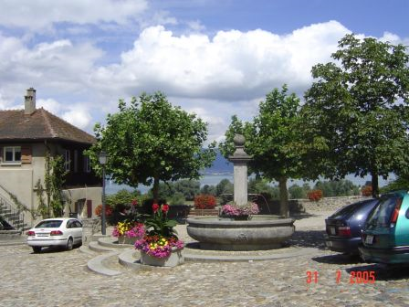
Introduction :
Make computers understand images and video.
What kind of scene?
Where are the cars?
How far is the building?

Slide 4
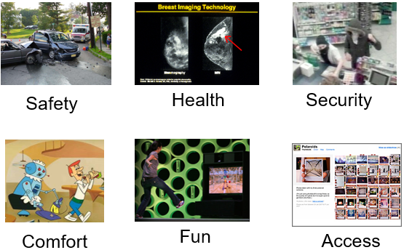
Business Problems
Why computer vision matters

Slide 5
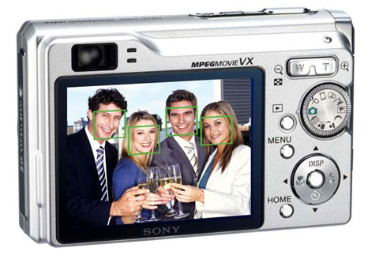
Background
This project is going to develop the computer vision ML security software
Developed ML Software is going to integrate with security cameras’ IOT feed image and video stream data.
Developed model will identify the images and send a notification to the responsible security personnel’s mobile device
Sample Images showing streamed Images
Smile detection (emotion detection)
Face detection

Slide 6
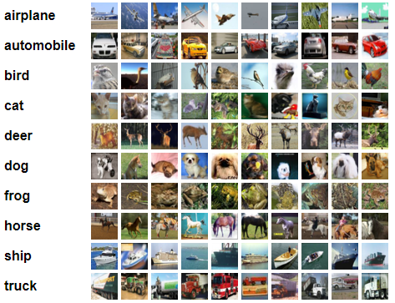
Dataset
The CIFAR-10 are labeled subsets of the 80 million tiny images dataset. Used Dataset was pulled from the Kera education library, and it doesn’t contain PII data.
It is a freely available dataset on the web and can be used for education and learning purposes.
For this Project I am using simple object images to train the models

Slide 7
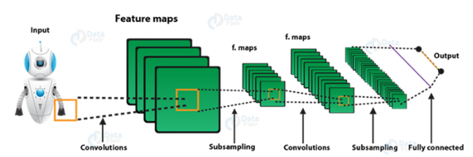
Model Building
Models were created using Deep learning & Convolutional Neural Networks.

Slide 8
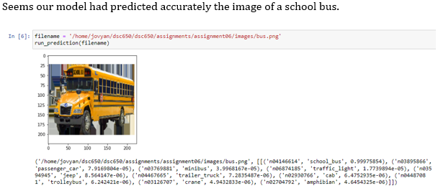
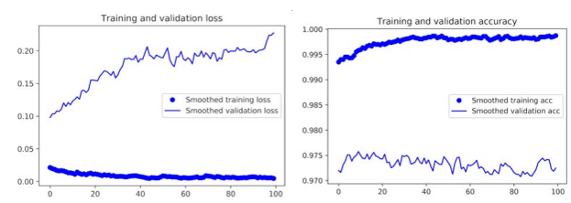
Conclusion & Recommendations
The training accuracy increases linearly over time, until it reaches nearly 100%, whereas the validation accuracy stalls at 70–72%.
After fine-tuning a network, The validation accuracy curve looks much cleaner. You’re seeing a nice 1% absolute improvement in accuracy, from about 96% to above 97%.
The generated fine tunned CNN model is the best fit for object predictions. We can use this classification model to develop Automatic object identification systems that can be designed for many processes such as university security systems

Slide 9
Ethical Considerations
This Data contains processed physical images information related to multiple Objects and does not contain any PII-related information.
Datasets and information on data were extracted from the public websites → kera libraries & UCL machine learning repositories.
This data research is not going to harm any privacy.

Slide 10

References
https://www.altexsoft.com/blog/image-recognition-neural-networks-use-cases/
https://data-flair.training/blogs/convolutional-neural-networks-tutorial/
https://www.cs.toronto.edu/~kriz/cifar.html
https://www.delltechnologies.com/asset/en-us/products/ready-solutions/industry-market/ai-driven-image-video-classification-white-paper.pdf
https://blog.keras.io/building-powerful-image-classification-models-using-very-little-data.html
Deep Learning with Python 1st Edition
Andrej Karpathy, The Unreasonable Electiveness of Recurrent Neural Networks

Slide 11
Expected Audience Questions (refer to white paper for answers)
In the Real world how the data science team is going to capture the required student biometric data
What type of legal considerations do we need to deal with during scaling out this project?
Do you have any best practices for handling sensitive data?
Do the data processing in-house and procure the required equipment & Software for capturing & process the human image data.
What would be our revenue model?
How accurate is your Model?
The presented solution or model is meant for identifying few types of objects How you are going to make it fit for other varieties?
How the Model is designed to behave with unknown grain data.
With the increase in counts of varieties of objects and human faces images, are you expecting any degradation in, accuracy?
Do you have a recommendation for making the model prediction more consistent:

Slide 12

Thank you very Much !!

